Slide 1
Sprint Retrospective
Office Queue - Team 7

Slide 2
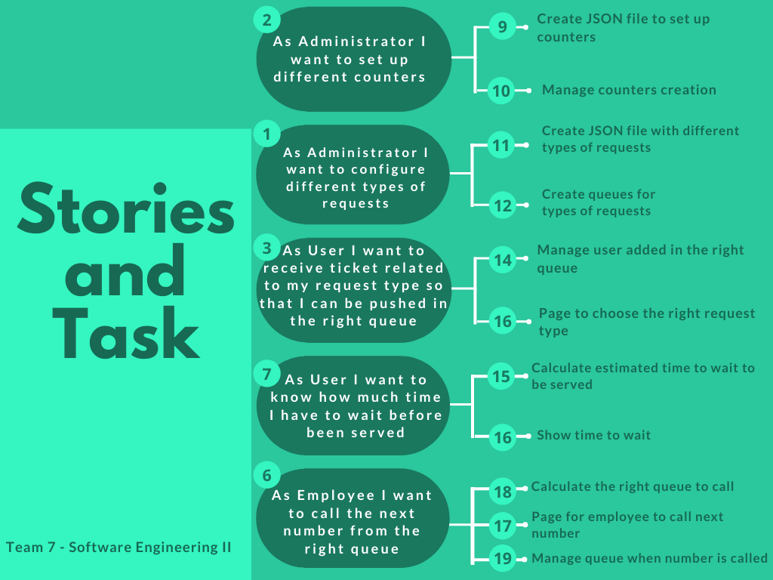

Slide 3
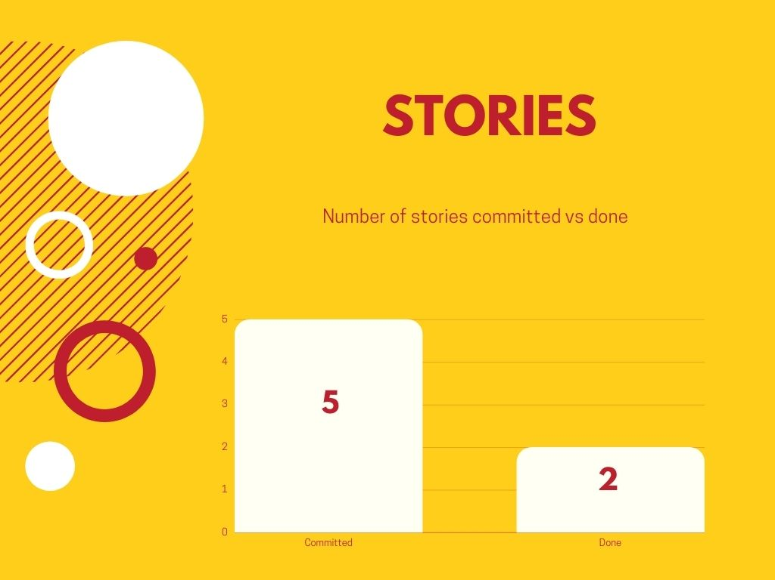
Process: Macro statistics

Slide 4
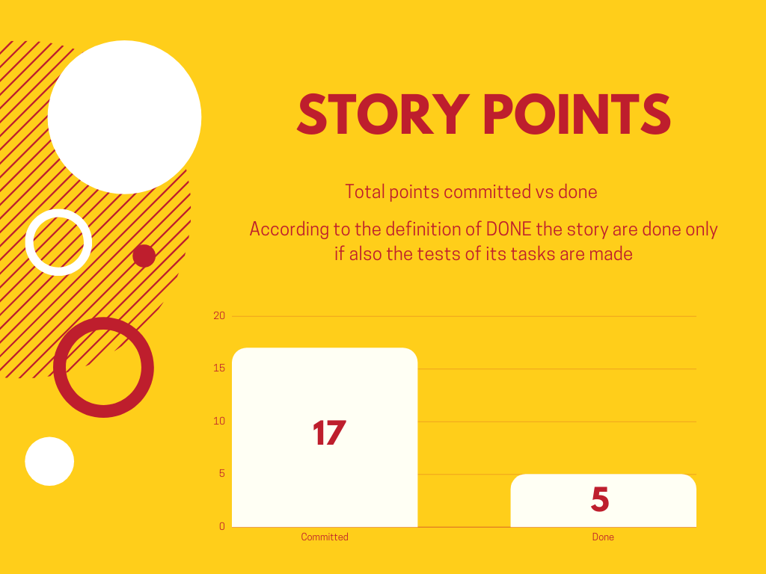
Process: Macro statistics

Slide 5
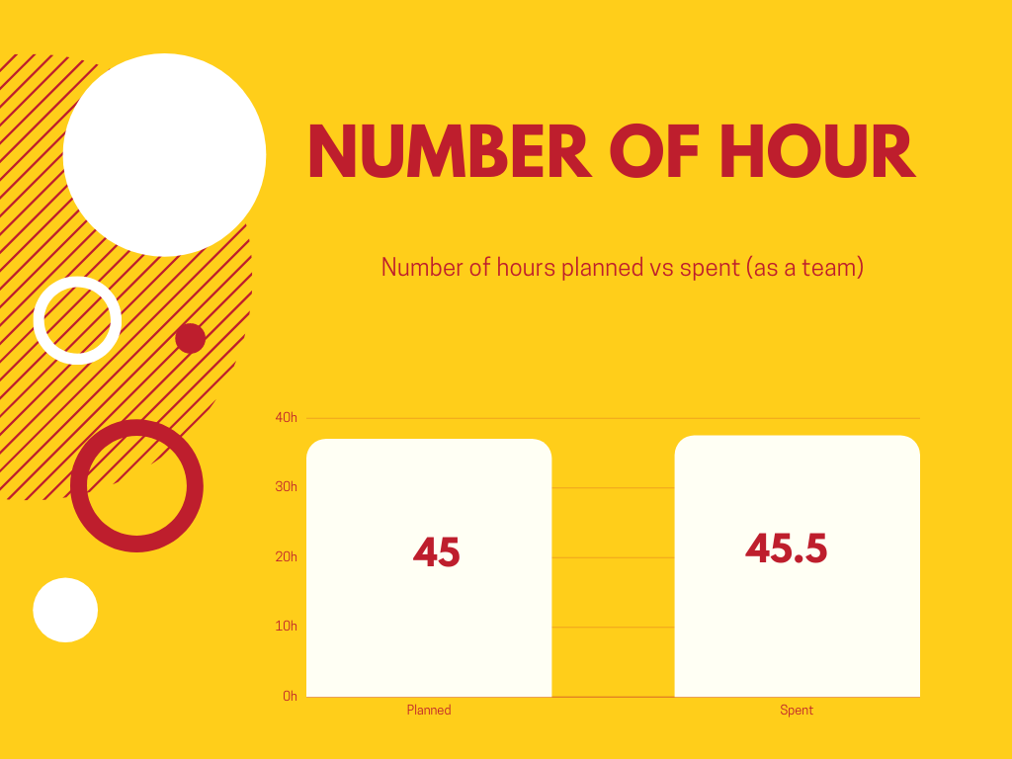
Process: Macro statistics

Slide 6
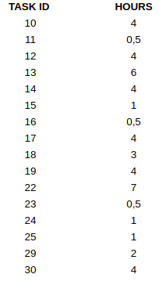
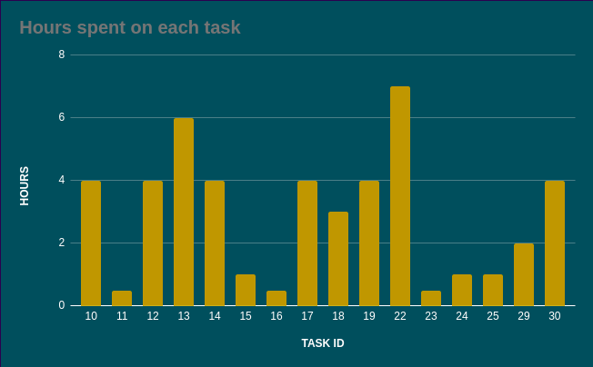

Process: Detailed statistics

Slide 7
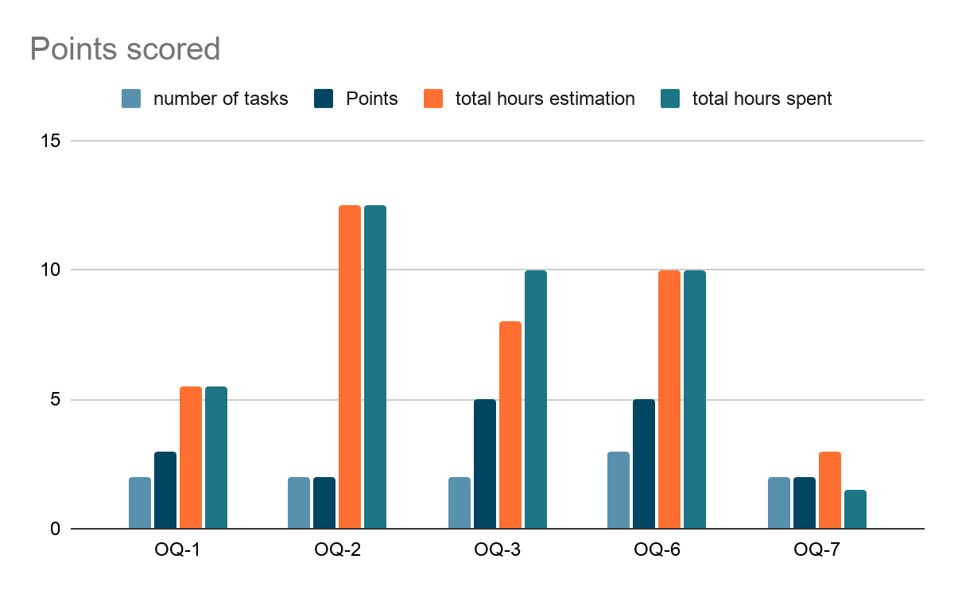
Process: Detailed statistics
ID_Story | number of tasks | Points | total hours estimation | total hours spent
OQ-1 | 2 | 3 | 5,5 | 5,5
OQ-2 | 2 | 2 | 12,5 | 12,5
OQ-3 | 2 | 5 | 8 | 10
OQ-6 | 3 | 5 | 10 | 10
OQ-7 | 2 | 2 | 3 | 1,5
Sum | 11 | 17 | 39 | 39,5

Slide 8
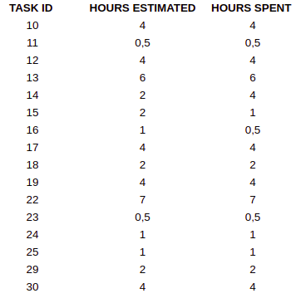
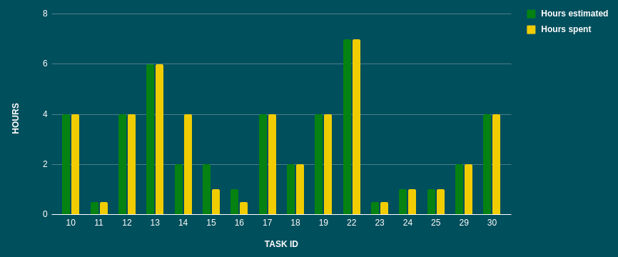

Process: Detailed statistics
The total task estimation error ratio is about: 0,99
Slight underestimation

Slide 9
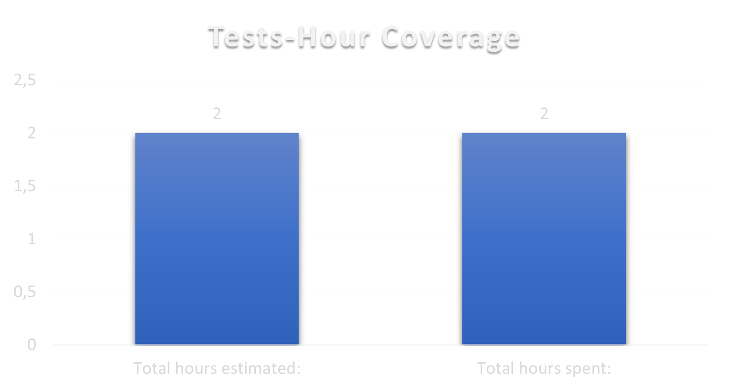
Quality: Unit Testing
Total hours estimated : 2 h
Total hours spent : 2 h
Number of automated unit tests: 23 tests

Slide 10
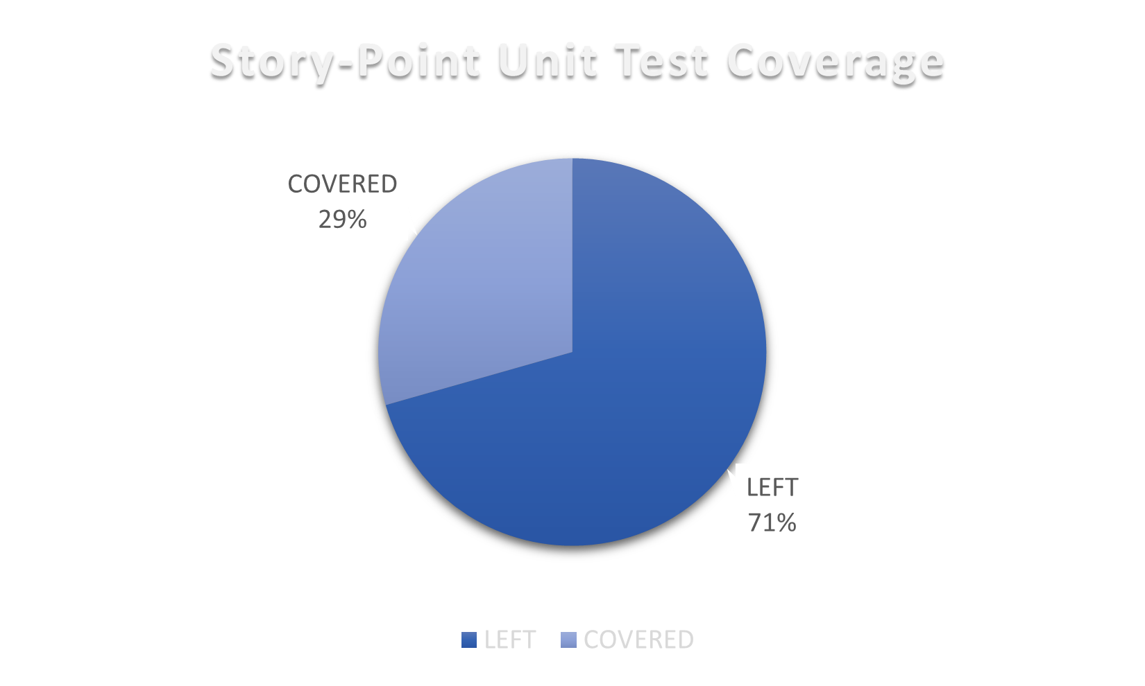
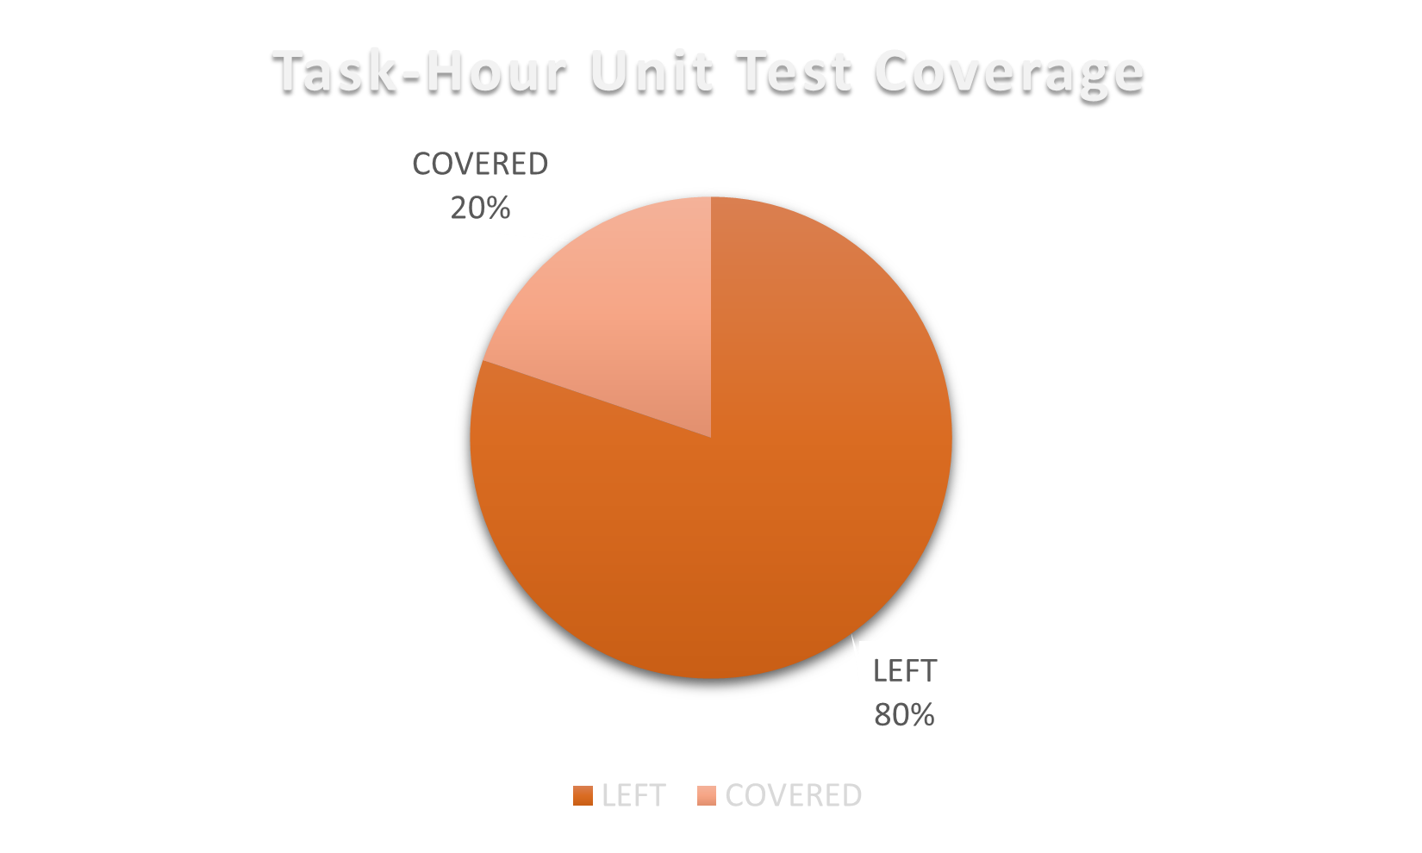
Quality: Unit Testing
Total Story Points of work done : 17 SP
Total Story Points covered by tests : 5 SP
Total hours of work done: 45.5 h
Total hours of work covered by tests: 9 h

Slide 11
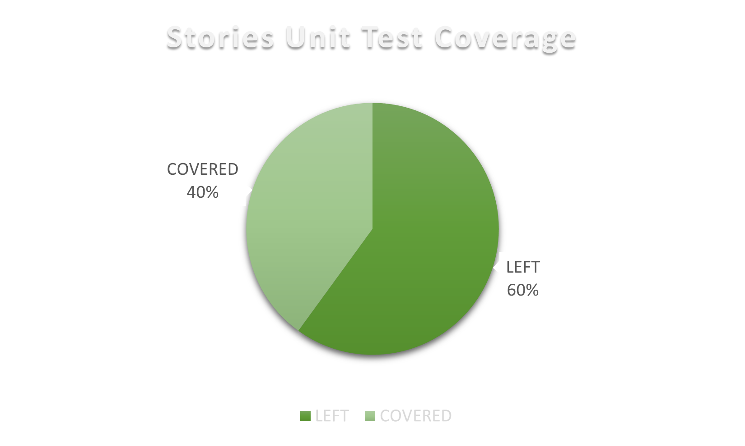
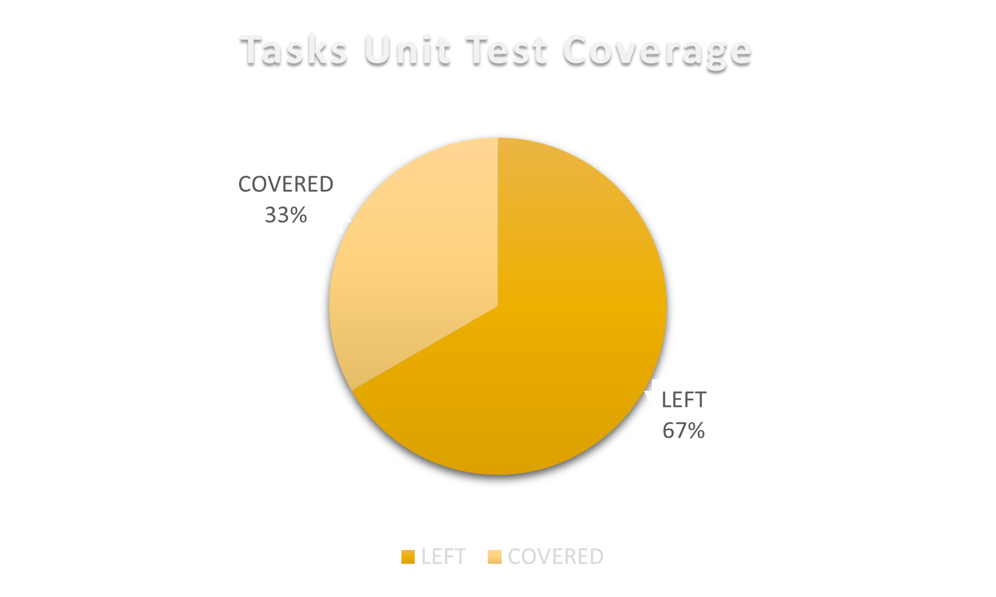
Quality: Unit Testing
Number of stories in the Sprint: 5 stories
Number of stories covered by tests: 2 stories
Number of technical tasks in the sprint : 12 tasks
Number of technical tasks covered by tests : 4 tasks

Slide 12
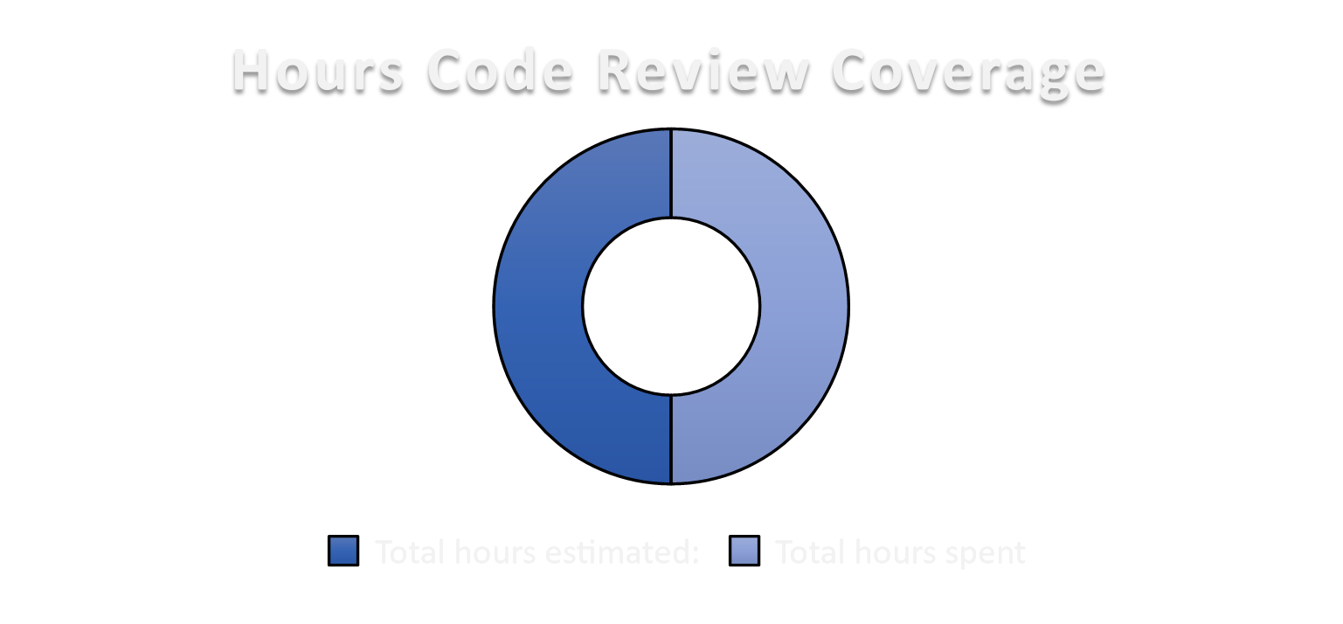
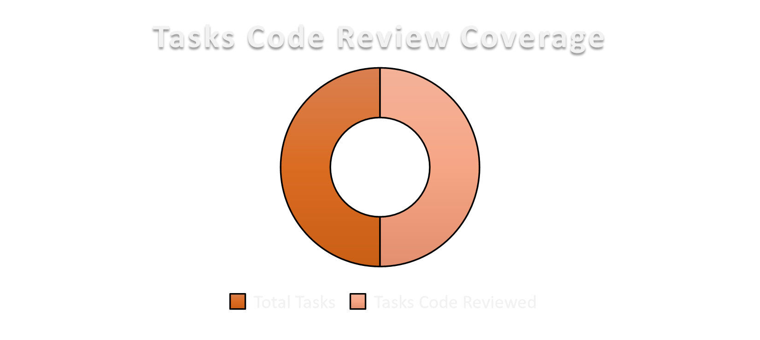
Quality: Code Review
Hours of code-review estimated: 6 h
Hours of code-review spent: 6 h
Number of Tasks: 12 tasks
Number of Tasks-Code reviewed: 12 tasks

Slide 13
Assessment
We did not complete all the planned stories, because we realized that, according to the definition of “done”, every story should have been tested.
We decided then to include the testing phase in the current sprint, but we were running out of time so not everything has been tested.
We have also underestimated the time that has been necessary to set up the base project and to coordinate the team. Anyway we have been very communicative and helpful to each others from the beginning and this helped us a lot to enjoy the work and to make up for the time that we lost the first days of the sprint.
We learnt that keeping in touch almost everyday increases our productivity and motivate us.

Slide 14
Assessment
We discussed about the stackholders’ feedback and we draw conclusions that will help us in the future sprints.
Stackholders suggest us to increase the text dimension of the user interface in order to make it simple to use for older people too.
We agreed that our future goals will be:
take in consideration initial set up time for the project
include a test task for every technical task
realize a user friendly interface
spend more time on code review

Slide 15

Thanks for the attention
Team 7:
Buscema Gaetano
Giorgi Benedetta
La Rocca Alessandro
Serafino Damiano
Valfrè Giosuè
Zhang Yuexin

